Slide 1
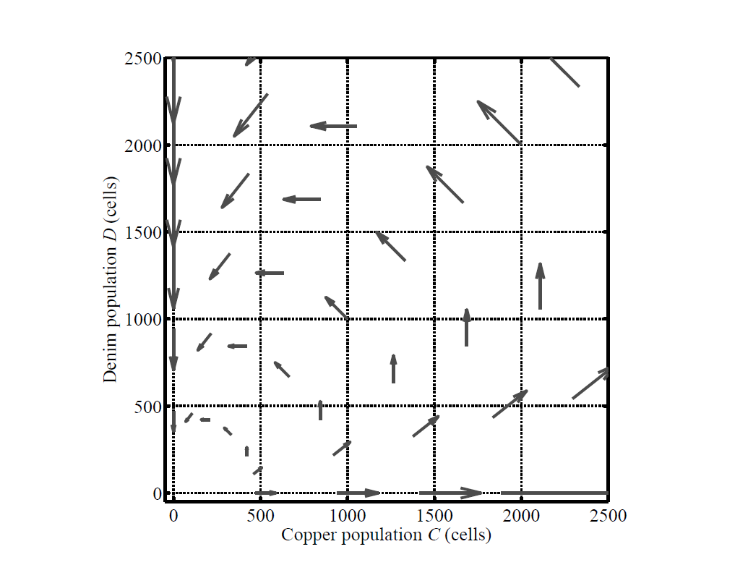
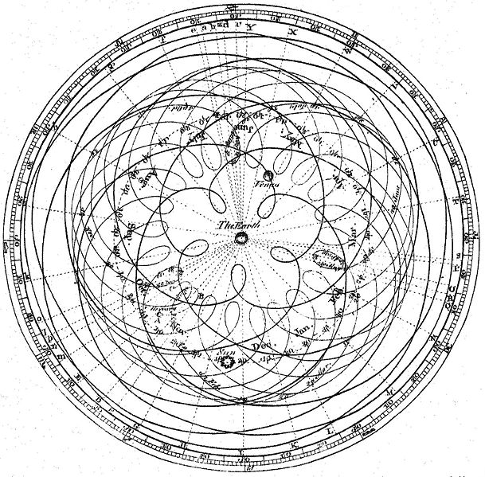
Evolutionary game theory for biologists
Population dynamics
Manual data analysis
Epicycles
Modularity
+
David Liao
Analyst, Tlsty Lab, UCSF
2013 August 12
Princeton/Johns Hopkins Game Theory Workshop, Baltimore, MD

Slide 2
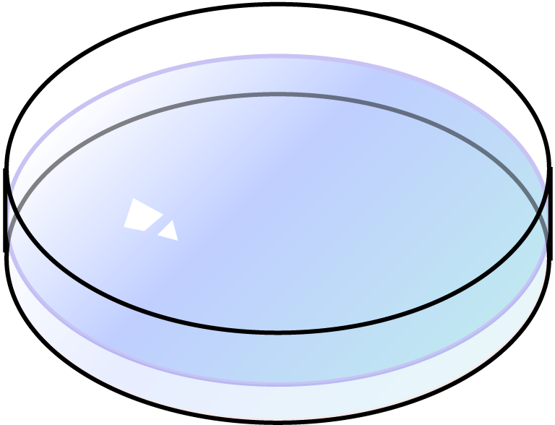
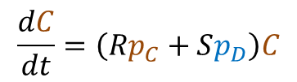


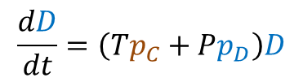
Basic model with pairwise interactions
Population dynamics
$$\frac{dC}{dt}=\left(Rp_{C}+Sp_{D}\right)C$$
$$p_{C}=\frac{C}{\left(C+D\right)}$$
$$\frac{dD}{dt}=\left(Tp_{C}+Pp_{D}\right)D$$
$$p_{D}=\frac{D}{\left(C+D\right)}$$
Note: Using labels C, D, T, R, P, and S does not, itself, logically imply that this model be a “prisoner’s dilemma”

Slide 3
Evolutionary game theory for biologists
Population dynamics
Manual data analysis
Epicycles
Modularity
+
David Liao
Analyst, Tlsty Lab, UCSF
2013 August 12
Princeton/Johns Hopkins Game Theory Workshop, Baltimore, MD

Slide 4
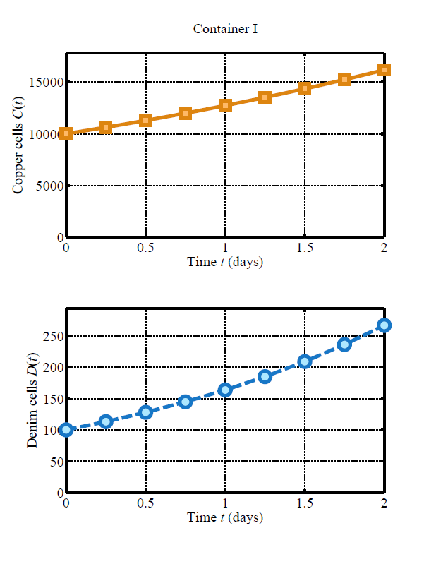
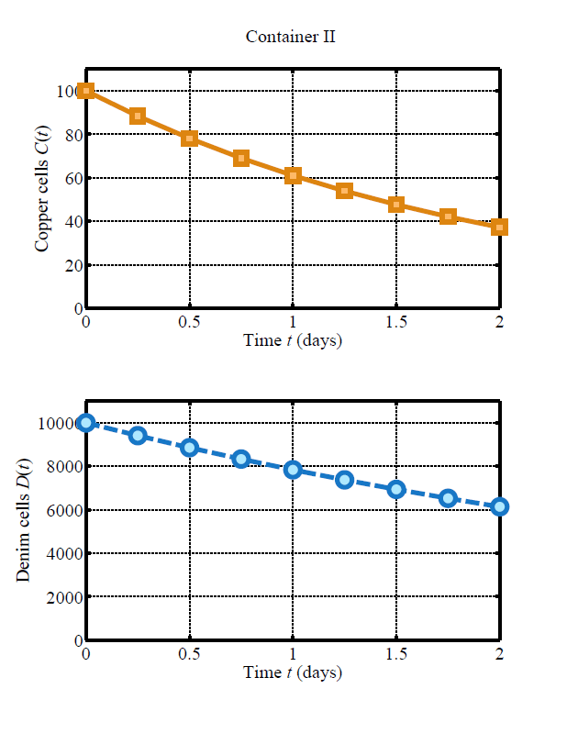
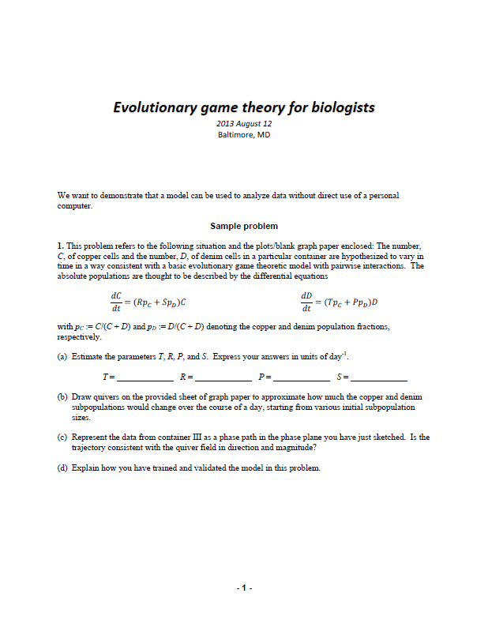
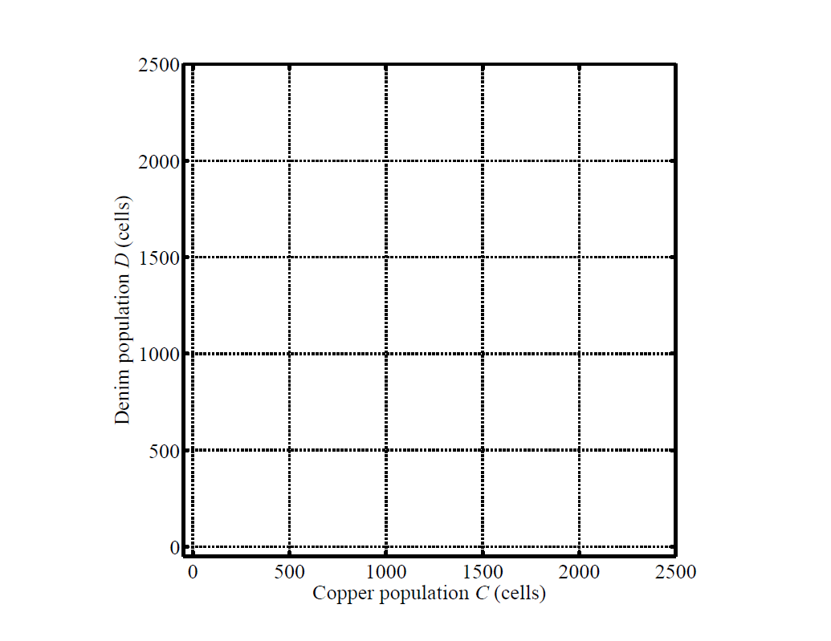
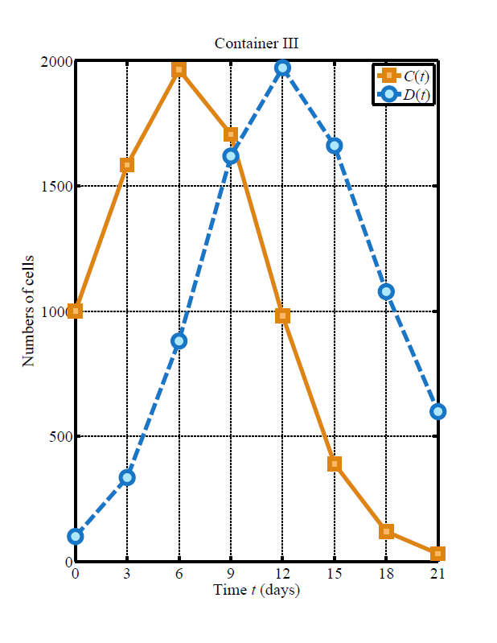
Back-of-the-envelope data analysis

Slide 5
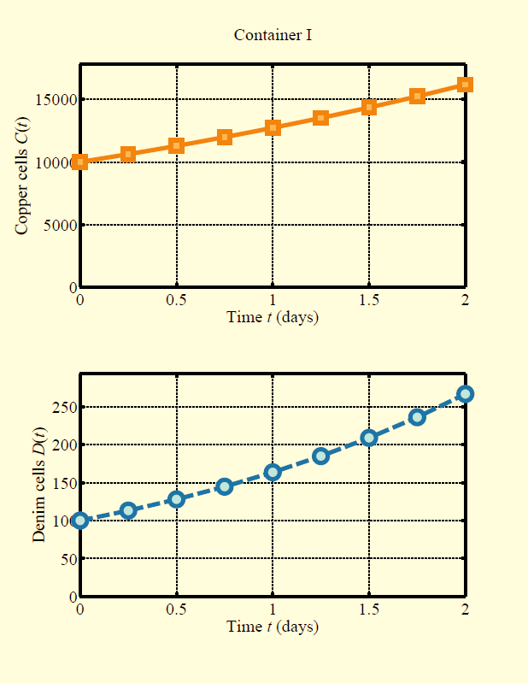
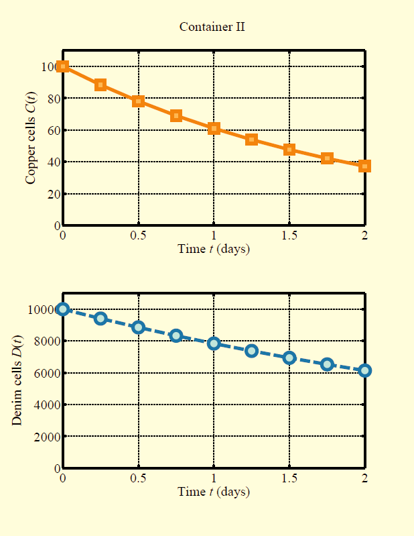
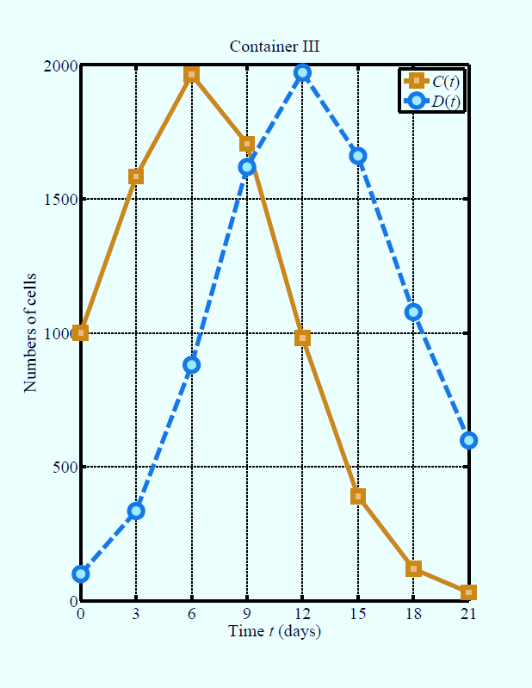
Back-of-the-envelope data analysis

Slide 6
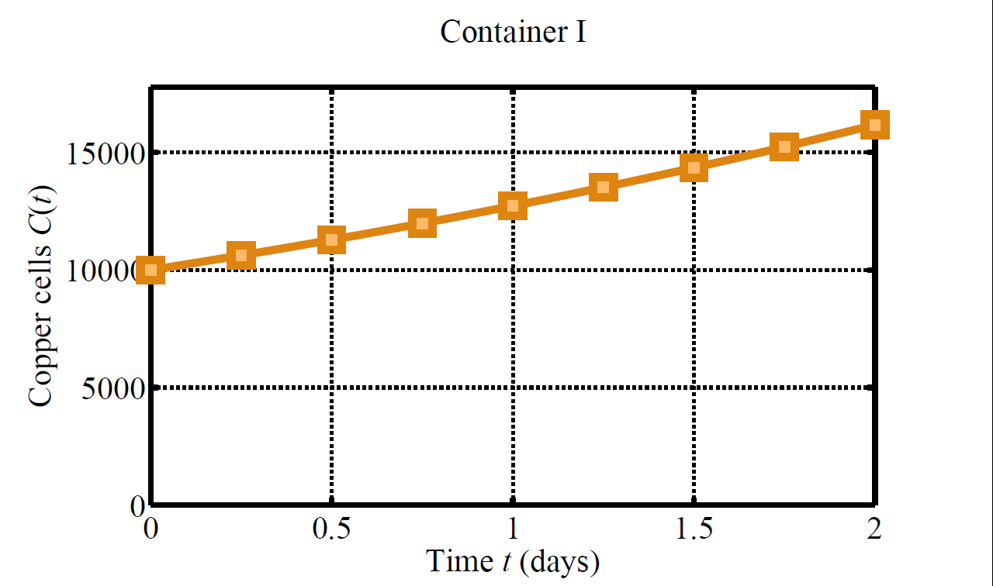
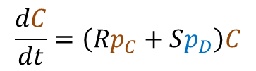

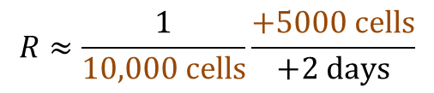


Estimating rate coefficient from initial slope
(a) Estimate the parameters T, R, P, and S. Express your answers in units of day⁻¹.
T = 0.5 day⁻¹; R = 0.25 day⁻¹; P = -0.25 day⁻¹; S = -0.5 day⁻¹
Seeded 10,000 copper cells and only 100 denim cells
$$\frac{dC}{dt}=\left(Rp_{C}+Sp_{D}\right)C$$
$$\frac{dC}{dt}≈RC$$
(if p_{C} ~ 1)
$$\frac{1}{C}\frac{∆C}{∆t}≈R$$
+5000 cells
+2 days
$$R≈\frac{1}{10,000 cells}\frac{+5000 cells}{+2 days}$$
$$=\frac{1}{4}{day}^{−1}$$

Slide 7
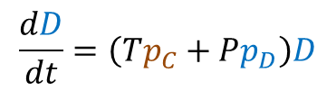





Using a model to fill in a phase plane
(b) Draw quivers on the provided sheet of graph paper to approximate how much the copper and denim subpopulations would change over the course of a day, starting from various initial subpopulation sizes.
Start from C = D = 2000, find population change over a day?
$$∆C≈\frac{dC}{dt}∆t$$
$$\frac{dC}{dt}=\left(Rp_{C}+Sp_{D}\right)C$$
$$∆C≈\left[\left(0.25 {day}^{−1}\right)\left(0.5\right)+\left(−0.5 {day}^{−1}\right)\left(0.5\right)\right]\left(2000 cells\right)\left(1 day\right)$$
$$∆C≈−250 cells$$
$$∆D≈\frac{dD}{dt}∆t$$
$$\frac{dD}{dt}=\left(Tp_{C}+Pp_{D}\right)D$$
$$∆D≈\left[\left(0. 5 {day}^{−1}\right)\left(0.5\right)+\left(−0.25 {day}^{−1}\right)\left(0.5\right)\right]\left(2000 cells\right)\left(1 day\right)$$
$$∆D≈+250 cells$$
T = 0.5 day⁻¹; R = 0.25 day⁻¹;
P = -0.25 day⁻¹; S = -0.5 day⁻¹

Slide 8
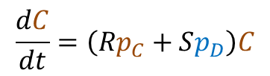

Using a model to fill in a phase plane
(b) Draw quivers on the provided sheet of graph paper to approximate how much the copper and denim subpopulations would change over the course of a day, starting from various initial subpopulation sizes.
From C = D = 2000,
$$∆C≈\frac{dC}{dt}∆t$$
$$\frac{dC}{dt}=\left(Rp_{C}+Sp_{D}\right)C$$
$$∆C≈−250 cells$$
$$∆D≈\frac{dD}{dt}∆t$$
$$\frac{dD}{dt}=\left(Tp_{C}+Pp_{D}\right)D$$
$$∆D≈+250 cells$$
T = 0.5 day⁻¹; R = 0.25 day⁻¹;
P = -0.25 day⁻¹; S = -0.5 day⁻¹

Slide 9
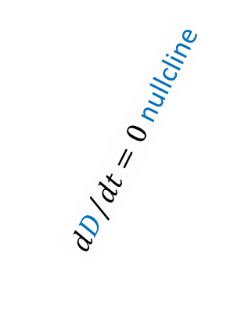
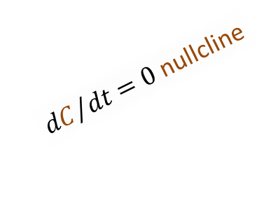
Using a model to fill in a phase plane
(b) Draw quivers on the provided sheet of graph paper to approximate how much the copper and denim subpopulations would change over the course of a day, starting from various initial subpopulation sizes.
From C = D = 2000,
$$∆C≈\frac{dC}{dt}∆t$$
${dD}/{dt}=0$ nullcline
$$\frac{dC}{dt}=\left(Rp_{C}+Sp_{D}\right)C$$
$$∆C≈−250 cells$$
$$∆D≈\frac{dD}{dt}∆t$$
$$\frac{dD}{dt}=\left(Tp_{C}+Pp_{D}\right)D$$
${dC}/{dt}=0$ nullcline
$$∆D≈+250 cells$$
T = 0.5 day⁻¹; R = 0.25 day⁻¹;
P = -0.25 day⁻¹; S = -0.5 day⁻¹

Slide 10
Back-of-the-envelope data analysis

Slide 11
Validating model using phase path
(c) Represent the data from container III as a phase path in the phase plane you have just sketched. Is the trajectory consistent with the quiver field in direction and magnitude?
1 day
3 days

Slide 12
Back-of-the-envelope data analysis
Recently, ideas about complexity, self-organization, and emergence--when the whole is greater than the sum of its parts--have come into fashion as alternatives for metaphors of control. But such explanations offer only smoke and mirrors, functioning merely to provide names for what we can't explain; they elicit for me the same dissatisfaction I feel when a physicist says that a particle's behavior is caused by the equivalence of two terms in an equation. . . .
The hope that general principles will explain the regulation of all the diverse complex dynamical systems that we find in nature can lead to ignoring anything that doesn't fit a pre-existing model. When we learn more about the specifics of such systems, we will see where analogies between them are useful and where they break down.
--Deborah Gordon (2007)
Control without hierarchy. Nature 446: 143
A mixture of cell subpopulations proliferates with fitnesses linearly dependent on population composition
Momentum is conserved

Slide 13
Evolutionary game theory for biologists
Population dynamics
Manual data analysis
Epicycles
Modularity
+
David Liao
Analyst, Tlsty Lab, UCSF
2013 August 12
Princeton/Johns Hopkins Game Theory Workshop, Baltimore, MD

Slide 14




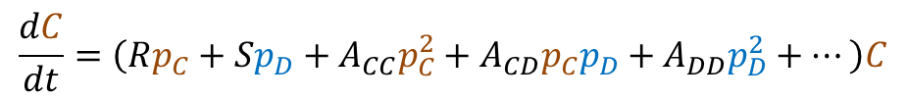
Mass action, Taylor series, and epicycles
Pairwise
Population dynamics
Pairwise collisions
3-way collisions
≥ 4-way
$$\frac{dC}{dt}=\left(Rp_{C}+Sp_{D}+A_{CC}p_{C}^{2}+A_{CD}p_{C}p_{D}+A_{DD}p_{D}^{2}+⋯\right)C$$
$$\frac{dC}{dt}=\left(Rp_{C}+Sp_{D}\right)C$$
Power-series for generic analytic function

Slide 15
Evolutionary game theory for biologists
Population dynamics
Manual data analysis
Epicycles
Modularity
+
David Liao
Analyst, Tlsty Lab, UCSF
2013 August 12
Princeton/Johns Hopkins Game Theory Workshop, Baltimore, MD

Slide 16


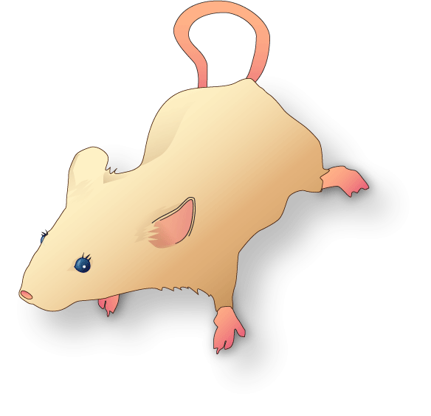


How complicated must our model be?
Intracellular
2 cell subpopulations
3 cell subpopulations
. . .
Patient
Mouse sketch file (and CC BY SA license information) at
commons.wikimedia.org/wiki/File:Vectorized_lab_mouse_mg_3263_for_scientific_figures_and_presentations.svg

Slide 17
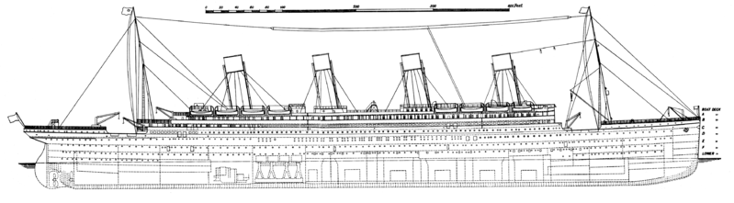


Modularity
$$≠$$
$$≈$$
Sophisticated computation
Fault containment, revision
How does time-varying environment in which life evolves determine scale(s) at which and mechanisms by which a system is integrated and/or segregated?
Given risks and economics, should compartments be tightly connected or well isolated?
Keep water out
Burn coal
Power engine
Turn propellers

Slide 18
Evolutionary game theory for biologists
Population dynamics
Manual data analysis
Epicycles
Modularity
+
David Liao
Analyst, Tlsty Lab, UCSF
2013 August 12
Princeton/Johns Hopkins Game Theory Workshop, Baltimore, MD

Slide 19
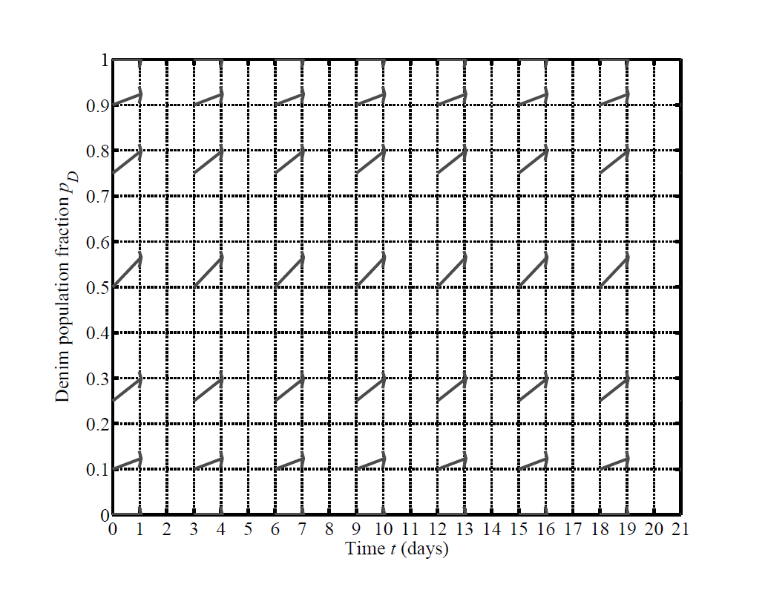


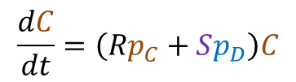
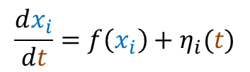
Questions
+
$$\frac{dx_{i}}{dt}=f\left(x_{i}\right)+η_{i}(t)$$
$$\frac{dC}{dt}=\left(Rp_{C}+Sp_{D}\right)C$$
Why doesn’t origin look like a saddle?
$$\frac{dD}{dt}=\left(Tp_{C}+Pp_{D}\right)D$$
Mechanisms
Direct contact
Indirect contact: Short-lived soluble factor
This validation of a mutation-free model also validates model with mutation
Compare results from 2-, 3-, 4-subpopulation experiments to infer modularity?
Motifs vs. modules
Kashtan & Alon 2005
Huang & Kauffman 2013
Acknowledgments
NIH/NCI U54CA143803 (Austin)
Thea Tlsty/Tlsty Lab

Slide 20
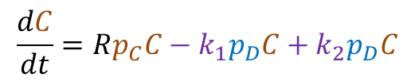
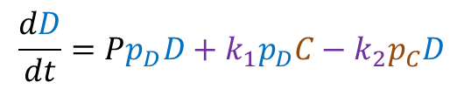
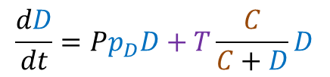
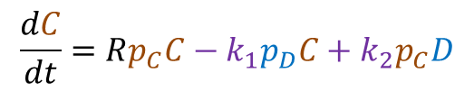
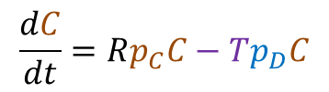

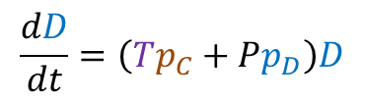

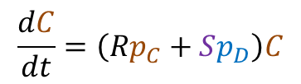
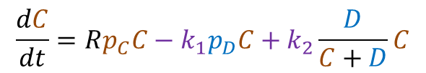
Validation of mutation-free model consistent with social mutation
+
$$\frac{dC}{dt}=\left(Rp_{C}+Sp_{D}\right)C$$
$$\frac{dD}{dt}=\left(Tp_{C}+Pp_{D}\right)D$$
$$+Tp_{D}C$$
In this example, S = -T
Two inconsistent mechanisms can be validated by one dataset because inconsistent mechanisms can generate the same governing equations.
Empirically validated = not yet rejected ≠ proved to be true
$$\frac{dC}{dt}=Rp_{C}C−Tp_{D}C$$
$$\frac{dD}{dt}=Pp_{D}D+T\frac{C}{C+D}D$$
Let T = k₁ – k₂
$$\frac{dC}{dt}=Rp_{C}C−k_{1}p_{D}C+k_{2}p_{D}C$$
Socially modulated mutation
$$\frac{dC}{dt}=Rp_{C}C−k_{1}p_{D}C+k_{2}\frac{D}{C+D}C$$
$$\frac{dC}{dt}=Rp_{C}C−k_{1}p_{D}C+k_{2}p_{C}D$$
$$+k_{2}p_{C}D$$
$$\frac{dD}{dt}=Pp_{D}D+k_{1}p_{D}C−k_{2}p_{C}D$$

